Slide 1
Analytics in Experience Analysis
Brian D. Holland, FSA, MAAA
Valuation Actuary Symposium
Session 76 - How to Use Predictive Modeling to Better Manage Your Life Insurance Inforce
August 27, 2019

Slide 2
Presentation Disclaimer
Presentations are intended for educational purposes only and do not replace independent professional judgment. Statements of fact and opinions expressed are those of the participants individually and, unless expressly stated to the contrary, are not the opinion or position of the Society of Actuaries, its cosponsors or its committees. The Society of Actuaries does not endorse or approve, and assumes no responsibility for, the content, accuracy or completeness of the information presented. Attendees should note that the sessions are audio-recorded and may be published in various media, including print, audio and video formats without further notice.
Additional disclaimer:
Any opinions presented herein are my own and not necessarily those of my employer, the SOA, or any others.

Slide 3
Overview
Welcome + thanks !
The link to the session:
Understanding what happened: for better portfolio management
  Supporting assumption choice: what past events to include or not
  Narrative of past events: always useful
Topics: ILEC work to incorporate analytics
  For industry experience insight
  For approaches
  Is work in progress!

Slide 4
Recent ILEC data:
Total experience

Slide 5
Q: How much data for 2009-15?
A: So much data: but slim in pockets
 | Exposure (Bil $-Yrs) | Exposure, Policy-Yrs (M) | Claims ($Bil) | Claims Policies (M)
Full dataset | 71,095 | 352.5 | 179 | 3.4
Adult issues | 68,447 | 282.2 | 177 | 3.2
Adult issues, face>$25k | 67,899 | 222.6 | 162 | 1.0

Slide 6
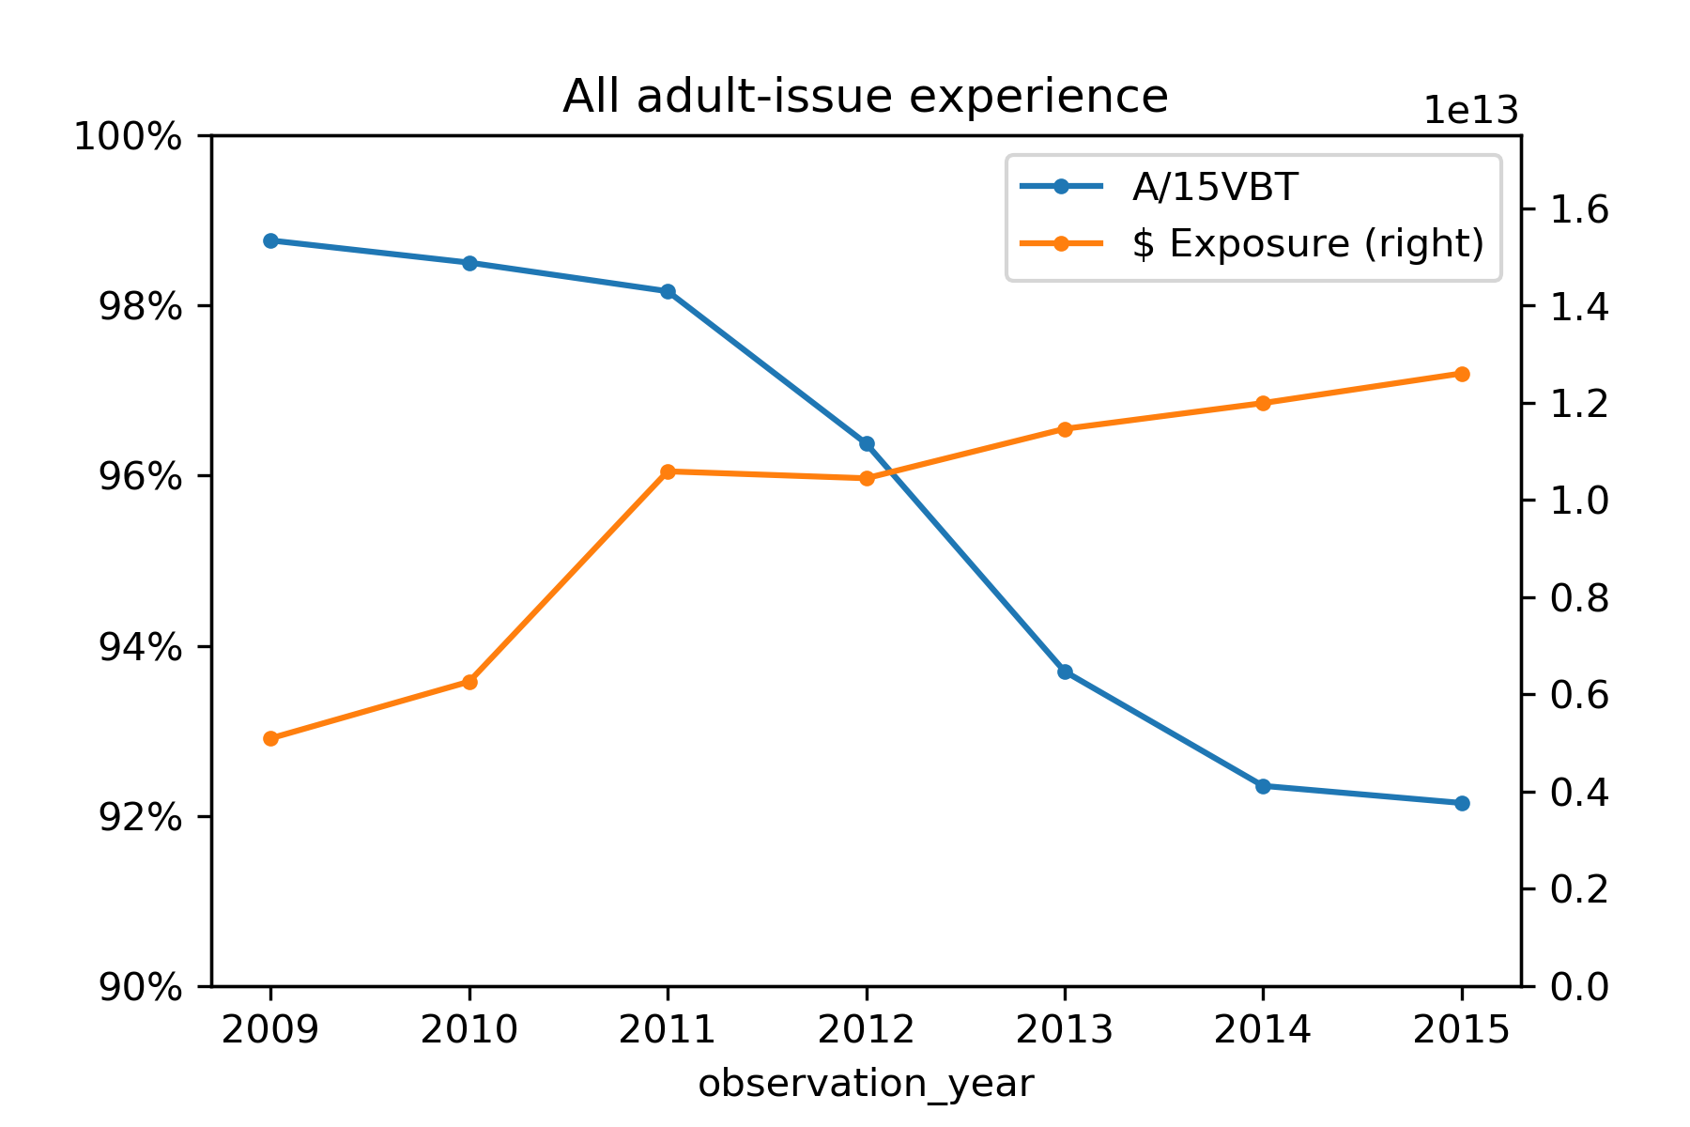
Adult issues, Actual/2015VBT, by Amount
A/15VBT has flattened out.
Exposure doubled 2010-1!
Influx of new exposure is further from 15VBT.
Question:
Did rates go up or down?
For future:
What could happen when more companies come in?

Slide 7
Rollforwards across study years

Slide 8
Rollforwards: what’s the point?
Mix of business is different each year.
A standard table will be high or low in some area.
Purpose: speak to the questions:
  Did the shifting mix cause the change in A/T?
  Did changing A/T cause the change in overall A/T?
Real answer: some of each – so how much?
Note – here I’m saying A/T for actual / table, for those of us who don’t expect the table.
Work in development to address these topics. Adult issues only, all face amounts, by face amount (not count)

Slide 9



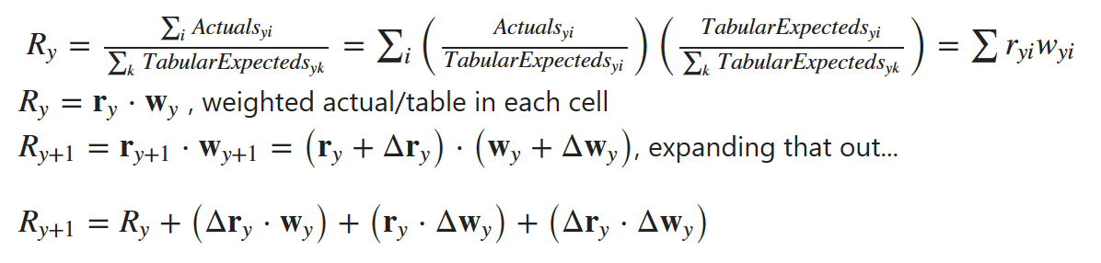
Rollforward: how does it work?
The actual/15VBT in one year is the one from the prior year plus a few changes: changes from three pieces:
updating ratios of actual/vbt
updating weight among the cells
A covariance effect

Slide 10
About that covariance-type component
If both the ratio and the weight for a cell increase, that pushes the overall ratio even more.
If both decrease: ditto
If they move in opposite directions: overall ratio drops
If one doesn’t move: no impact
Other notes:
  Aggregation level matters.
  Cells with exposure in one year but not the other have an undefined A/Table.
    I’m using the other year’s A/Table in that case to avoid some arbitrary impact.
  There’s room for more work: where certain odd years moved for example.

Slide 11
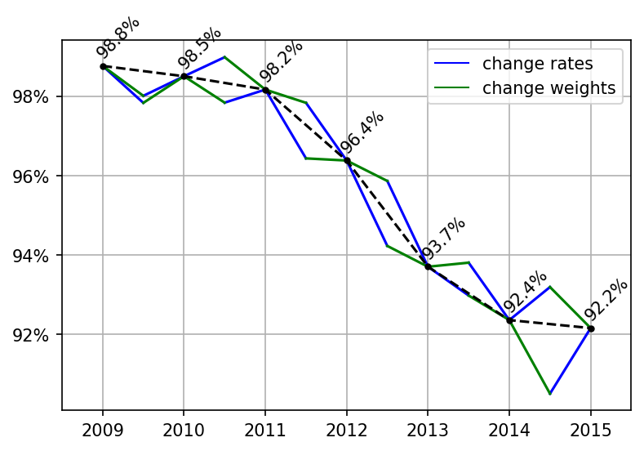
All products: sequential rollforward
Change one, then the other.
Covariance term lands in 2nd step.
From 2009-2010 big changes in mix lead to odd results:
In 2015 (from 2014 study to 2015 study) the A/15VBT went up, had been going down.
Explanations for 2014-5?
Slower mortality improvement?
Changed company mix?

Slide 12
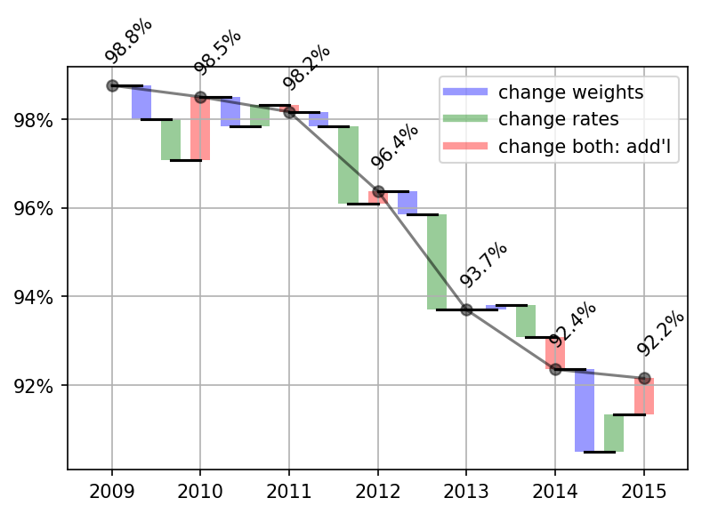
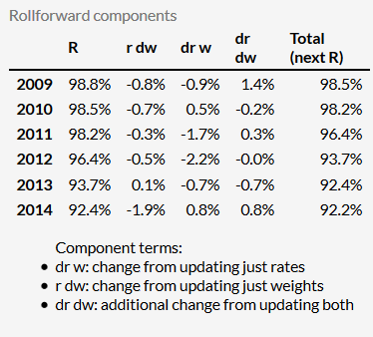
All business: waterfall: all 3 components
Waterfall presentation:
The covariance term makes a difference – even where results are not obviously weird.

Slide 13
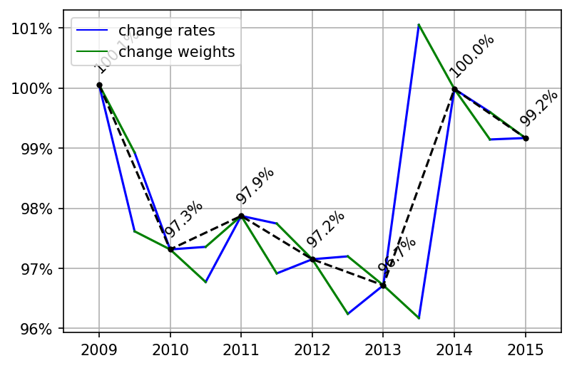
Perm
Large fluctuations from changes in rates.
Changes in weights on top of those have less impact.

Slide 14
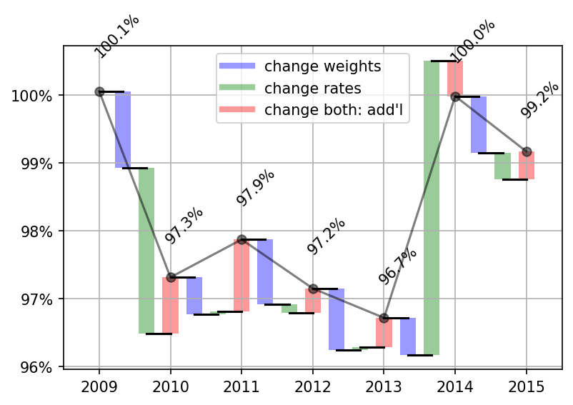
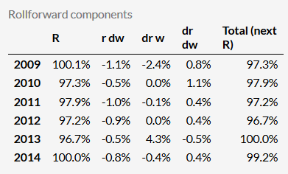
Perm: waterfall
Covariance term offsets only part of rate change in most years.
2010-11 had no change due to rates alone, but was large covariance impact.
Massive rate impact in 2013-4 only partly offset by covariance.

Slide 15
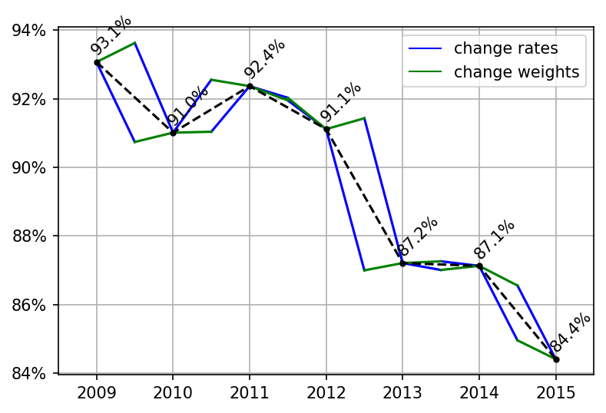
Term: sequential rollforward

Slide 16
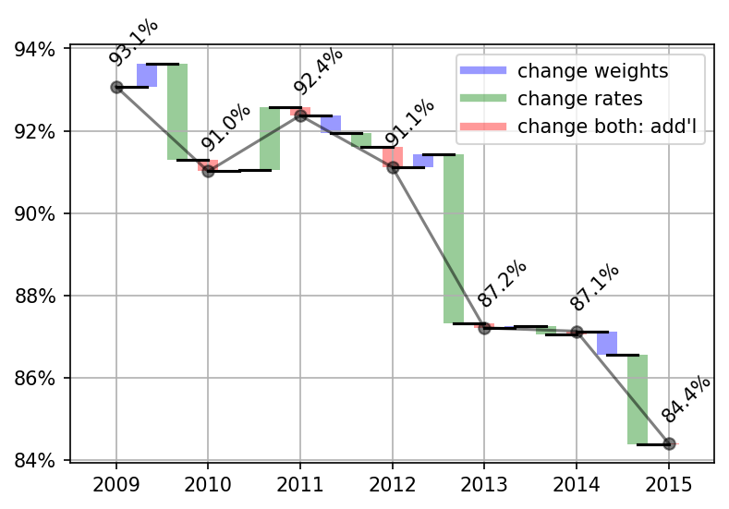
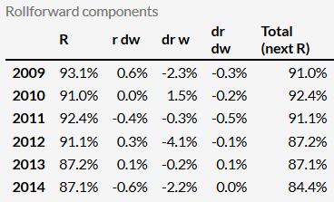
Term: waterfall
Very little covariance impact!
Little weights impact!
Dominated by several years with large drops vs 15VBT

Slide 17
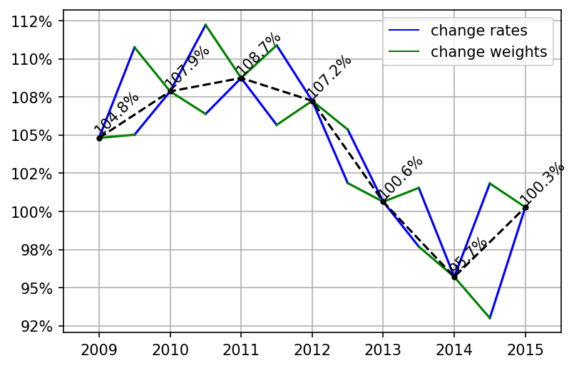
UL

Slide 18
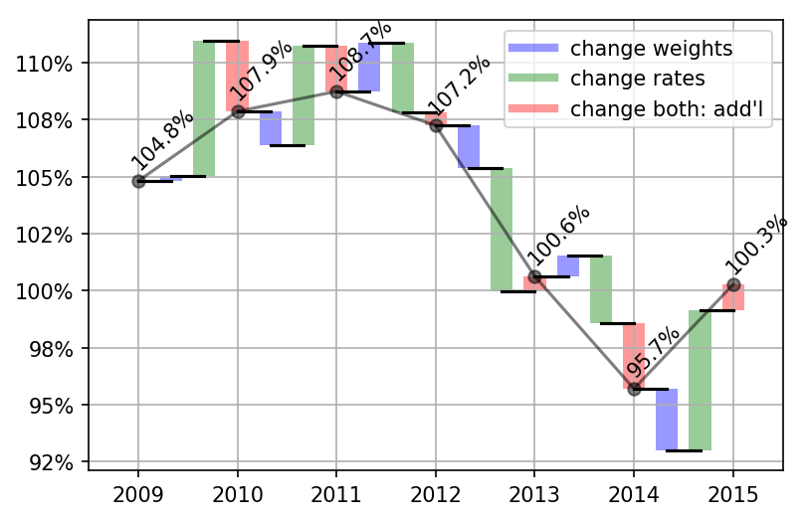
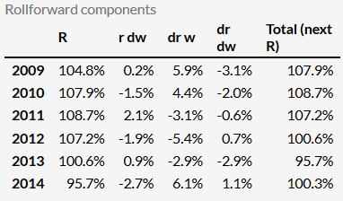
UL: waterfall
Weight change impact mixed
Large rate increase 2014-5
Large covar 2013-14 downward

Slide 19
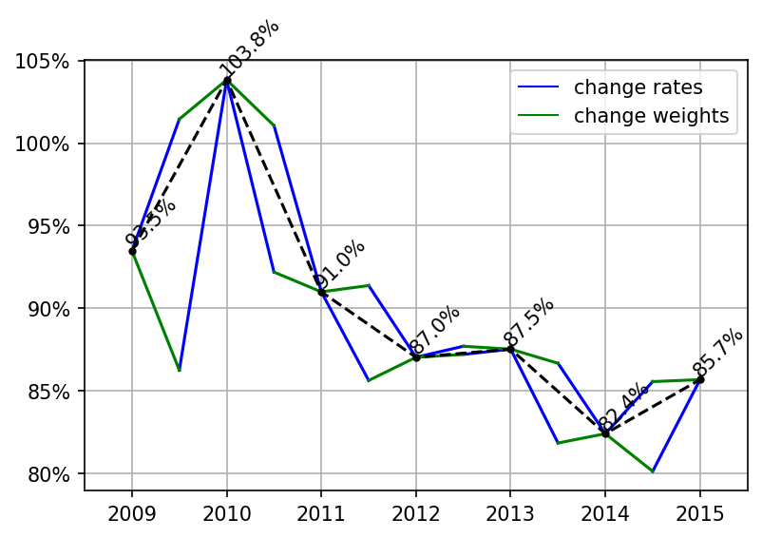
ULSG
Impacts largely consistent between steps
What will waterfall say…

Slide 20
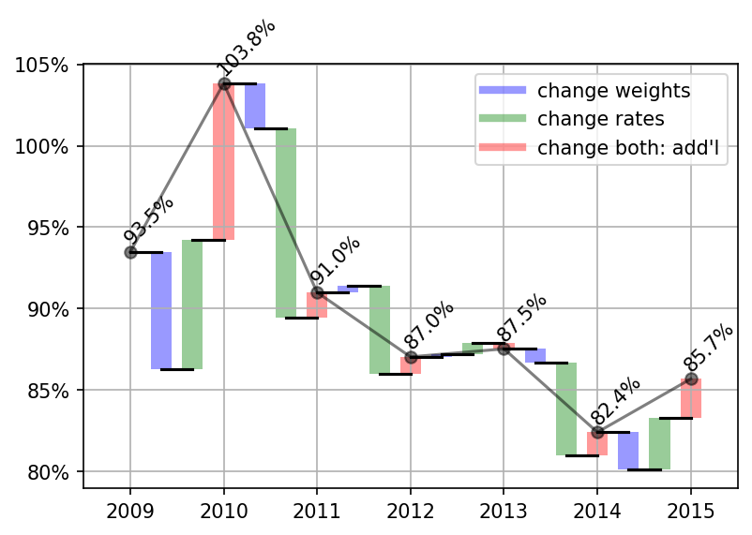
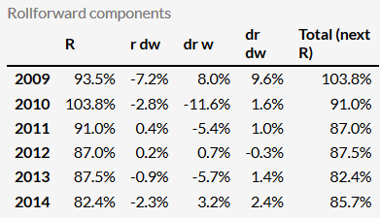
ULSG
Some relatively large covar impacts were masked:
2009-10, 2014-5
Recent years’ rate impact is inconsistent

Slide 21
Upshot - rollforward
Mix of business problem is known
One more tool to address it
Not as simple as we’d hope from the sequential rollforward

Slide 22
Anomaly detection

Slide 23
Anomaly detection
See where something was weird: computationally
Q: what is the “thing” – the entity?
  Study year – for example: Is it similar to others? If so, to which?
Ex: get a new study year: did exposure trend or jerk around?
For now: at least exposures should not be too jumpy –
  so see how jumpy they are on the following slides
For another time: check decrements (mortality and / or lapse)
  Must further anchor in probabilistic framework….
  Mortality is (hopefully) an anomaly at a granular level

Slide 24
PCA, SVD: for filtering out noise
WHAT: reduce dimensions used to measure entities (study years here)
WHY: 1) simplify calculations 2) some are just noise anyway
HOW:
Take average distribution across study years
Shift the mix from the average categories get best fit to distribution
  Add in an offset to that average distribution that’s scaled for each study year
  That scaling factor is a new 1st dimension, x coordinate
2. Add 2nd layer of shift to correct for remaining error: is new 2nd dimension
Could continue adding dimensions, but this is enough for now
3. Plot study years in 2-d
  Captures major features
  Shows trends more clearly and simply
  Facilitates cluster analysis to reduce dimensions
4. Could add further dimensions to capture remaining localized errors

Slide 25
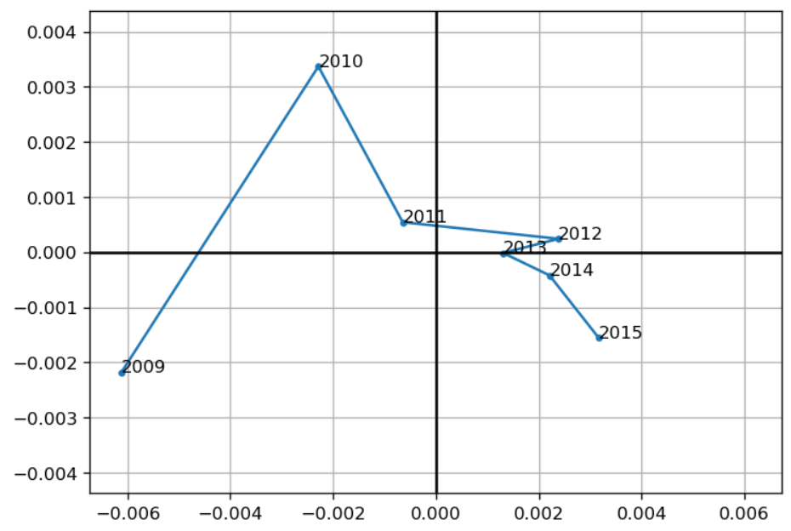
By insurance_plan, smoker_status, face_amount_band, issue_age
This exhibit conveys shift in mix of many different cross-categories at once.
Some are clearly in left field.
There are too many cross-combinations to show here: so let’s look at univariate mixes.

Slide 26
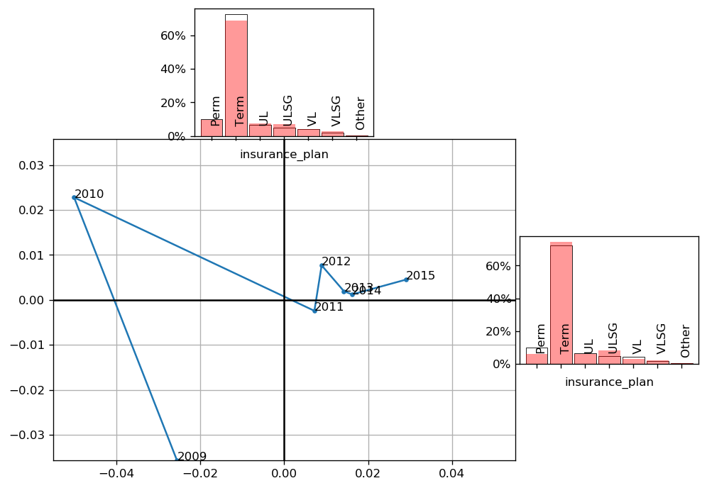
What this is: principal component analysis of mix of exposure (amount) from matrix of study year, plan: share of that study year’s total exposure
Black bars are average distribution across years.
Red bars show directionally to where the mix shifts going up the axis
Insurance plan
Going up on Y axis:
Less term, more UL and ULSG, bit more VLSG
Going right on X axis:
More term, ULSG; less perm, VL

Slide 27
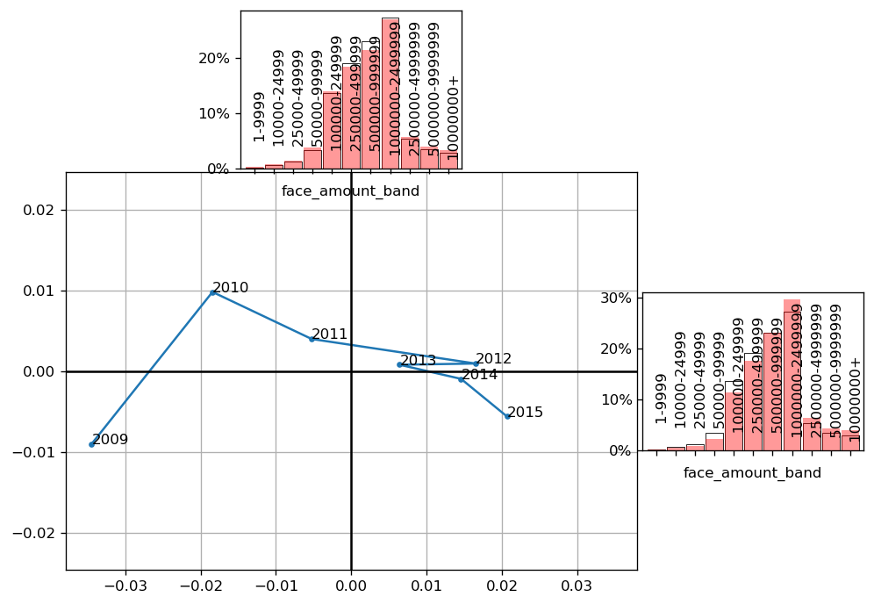
Face amount band
Going up on Y axis:
Less 250k-500k; 500k-1M.
More 2.5M+; <250k
Going right on X axis:
Less < 500k; more in each band 1M+

Slide 28
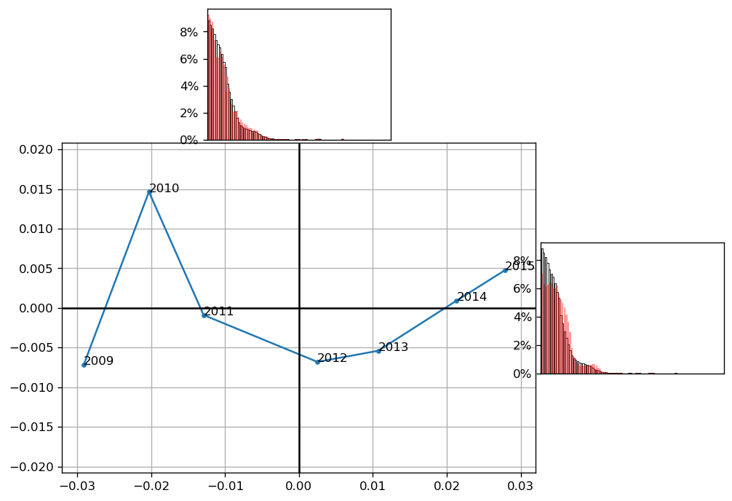
Duration
Going up on X axis:
Generally aging: makes some sense that
this one is smoother

Slide 29
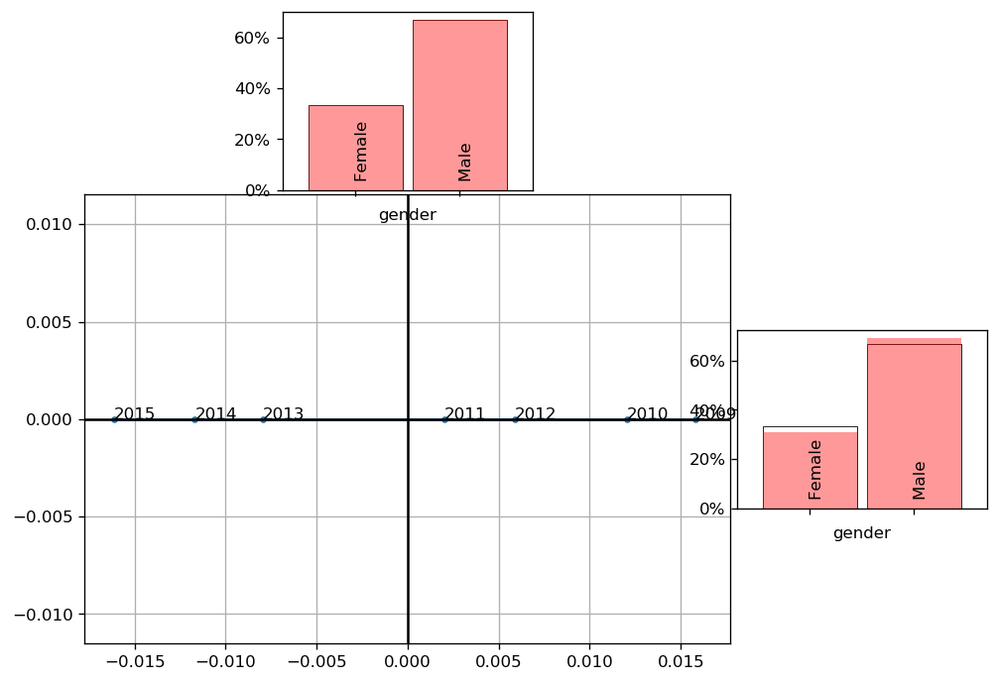
Gender
Going up on X axis:
More male
2012 back-tracked.
2013-5 showing even trend.
NOTE: is really one-dimensional
– think one degree of freedom
ALSO NOTE: these distributions should ideally be transformed out of the simplex into a real space.. But this is close enough to illustrate

Slide 30
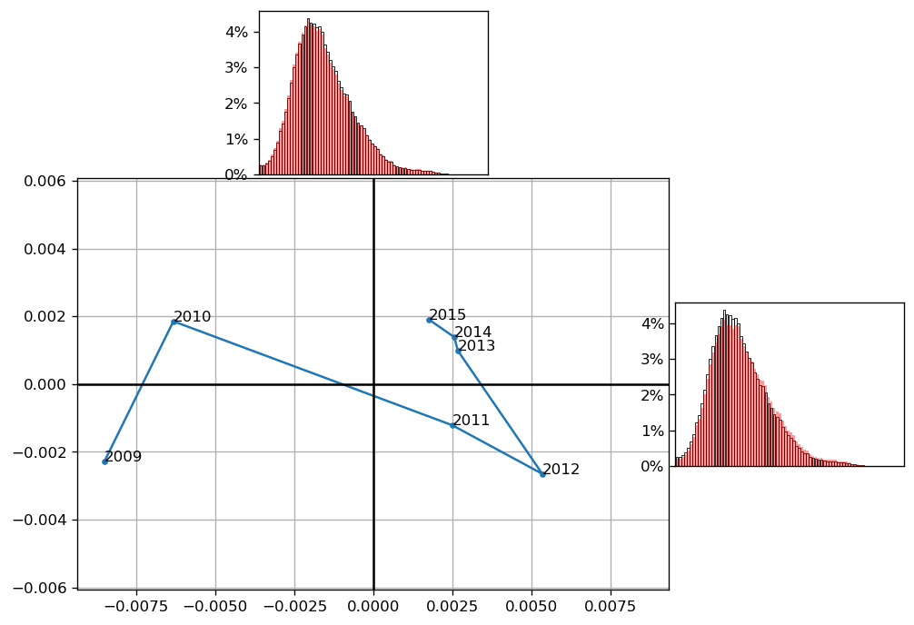
Issue age
Going up on Y axis:
Is younger issues (L of peak)
Going up on X axis:
More in higher ages.
Here 2009, 2010, 2012 also weird.

Slide 31
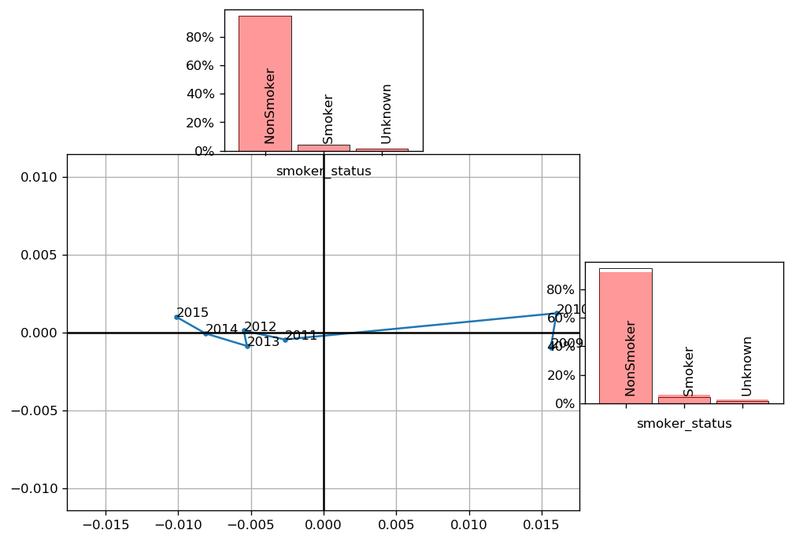
Smoker status
Going up on X axis:
More smoker.
So: more recent years have less smoker exposure,
More nonsmoker.

Slide 32
Clustering algorithms
Purpose: calculate the groups
Assign individuals to groups
  Individual years – other subsets
Ex: is the most recent year pretty similar to prior years
  – or did it zig instead of zag?
With few observations (like years) it makes less sense
  But the intuition is there: quantitatively address which one is an oddball
SVD reduces the number of dimensions of an entity to facilitate computation for large groups

Slide 33
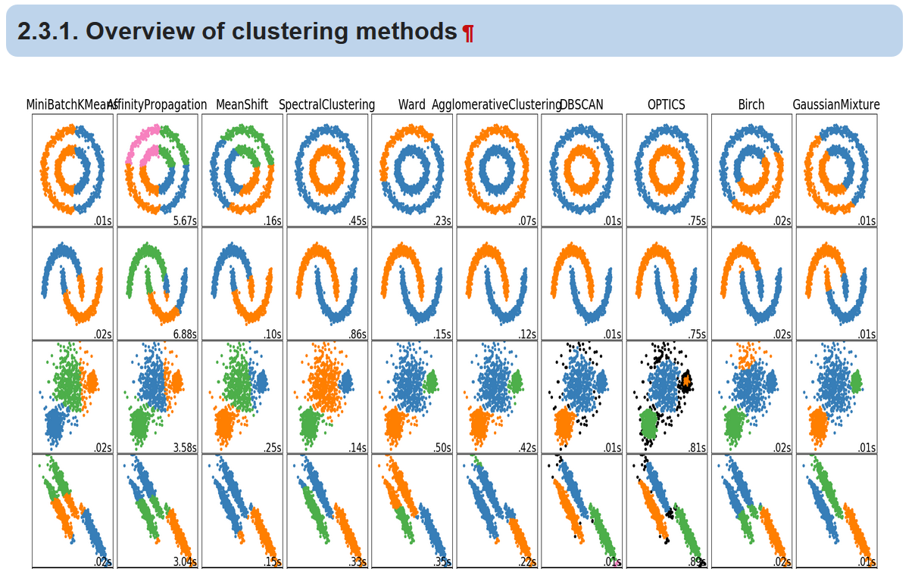
Clustering examples: Python scikit-learn package
https://scikit-learn.org/stable/modules/clustering.html
Different methods,
different types of situations

Slide 34
Recap – why this?
See where something was weird: computationally
Say whether new year – or other entity – is similar to others and if so to which: also computationally
Ex: new stat agent collecting data – hopefully no impact
More advanced: decrements (mortality and / or lapse)
  for later! Is even noisier
For now: at least exposures should not be too jumpy –
  But with increase in study size there were still movements

Slide 35
Many thanks for your attention!
Brian D. Holland, FSA, MAAA

